Slide 1

Workforce Analytics Deep Dive: Uncovering the Real Cost of Overtime
Comprehensive analysis of 1,142,146 working hours across 5,133 employees, integrating data from two distinct clocking systems to deliver unprecedented visibility into Stefanutti Stocks' workforce costs and overtime patterns for October 2024.

Slide 2

EXECUTIVE SUMMARY
Key Findings at a Glance
This analysis consolidated time and attendance data from two distinct clocking systems—biometric tracking for internal employees and client-provided PDF reports for external workers—providing Stefanutti Stocks with unprecedented visibility into workforce costs and overtime patterns.
R188.6M
19.3%
5,133
1.14M
Total Labour Cost
Overtime Premium
Employees Tracked
Working Hours
October 2024 payroll investment across all regions
R36.3M - significantly above 10-15% industry benchmark
Complete workforce coverage across both systems
Total hours analyzed for pattern identification
Critical Business Question
Concentration Points
"Why is overtime costing us nearly 20% of our labour budget?"
Inland region infrastructure projects (Roads & Earthworks)
The analysis reveals overtime is not evenly distributed—it concentrates in specific high-risk areas, creating opportunities for strategic intervention.
Production-critical roles (Crushers, Dump Trucks, Drivers)
High-value contracts with aggressive delivery timelines
This pattern suggests systemic scheduling challenges rather than isolated incidents.

Slide 3
CHAPTER 1
The Data Integration Challenge
Problem Statement
Stefanutti Stocks faced a critical data consolidation challenge: internal employees tracked via biometric systems (structured CSV format) while external and client employees were tracked through client access control systems (unstructured PDF reports). This created zero unified visibility into total workforce costs or overtime patterns.
PDF Report Complexities
Technical Solution Delivered
Measurable Results
Multi-line entries per employee requiring pattern matching
Developed a Python-based extraction pipeline using advanced regex pattern matching to parse multi-line PDF entries, extract and associate date headers with employee clock records, standardize time formats, and map external employees to projects via contract codes.
Successfully merged 1,142,146 records across 5,133 unique employees with 100% data capture from both systems—transforming fragmented data into actionable intelligence.
Date headers positioned above grouped records
No discipline or department categorization for external workers
Inconsistent time formats across different client sites
Data Quality Insights Discovered
Issue Identified
Impact
Status
Missing Discipline Tags
External employees lack department categorization
Analysis in progress
Clocking System Variance
Different rate structures between internal/external
Validated against payroll
Weekend Work Patterns
Significant Sunday/holiday work (OT2 premium rates)
Cost implications identified

Slide 4
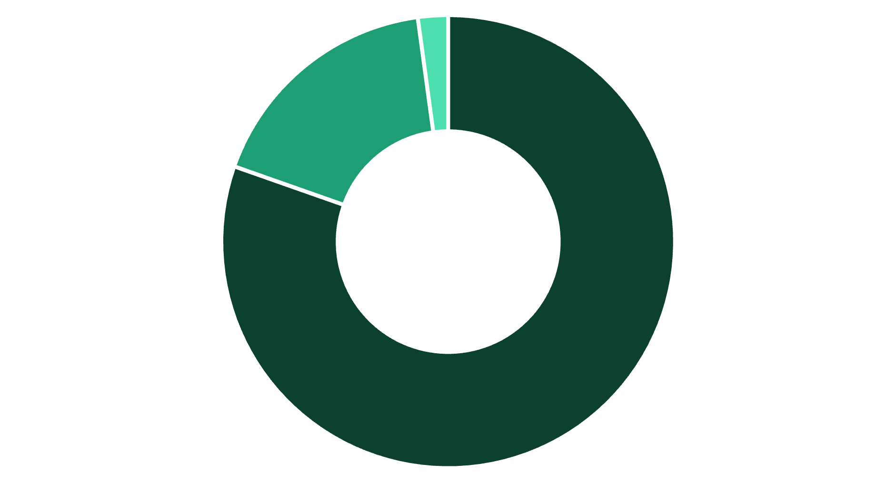
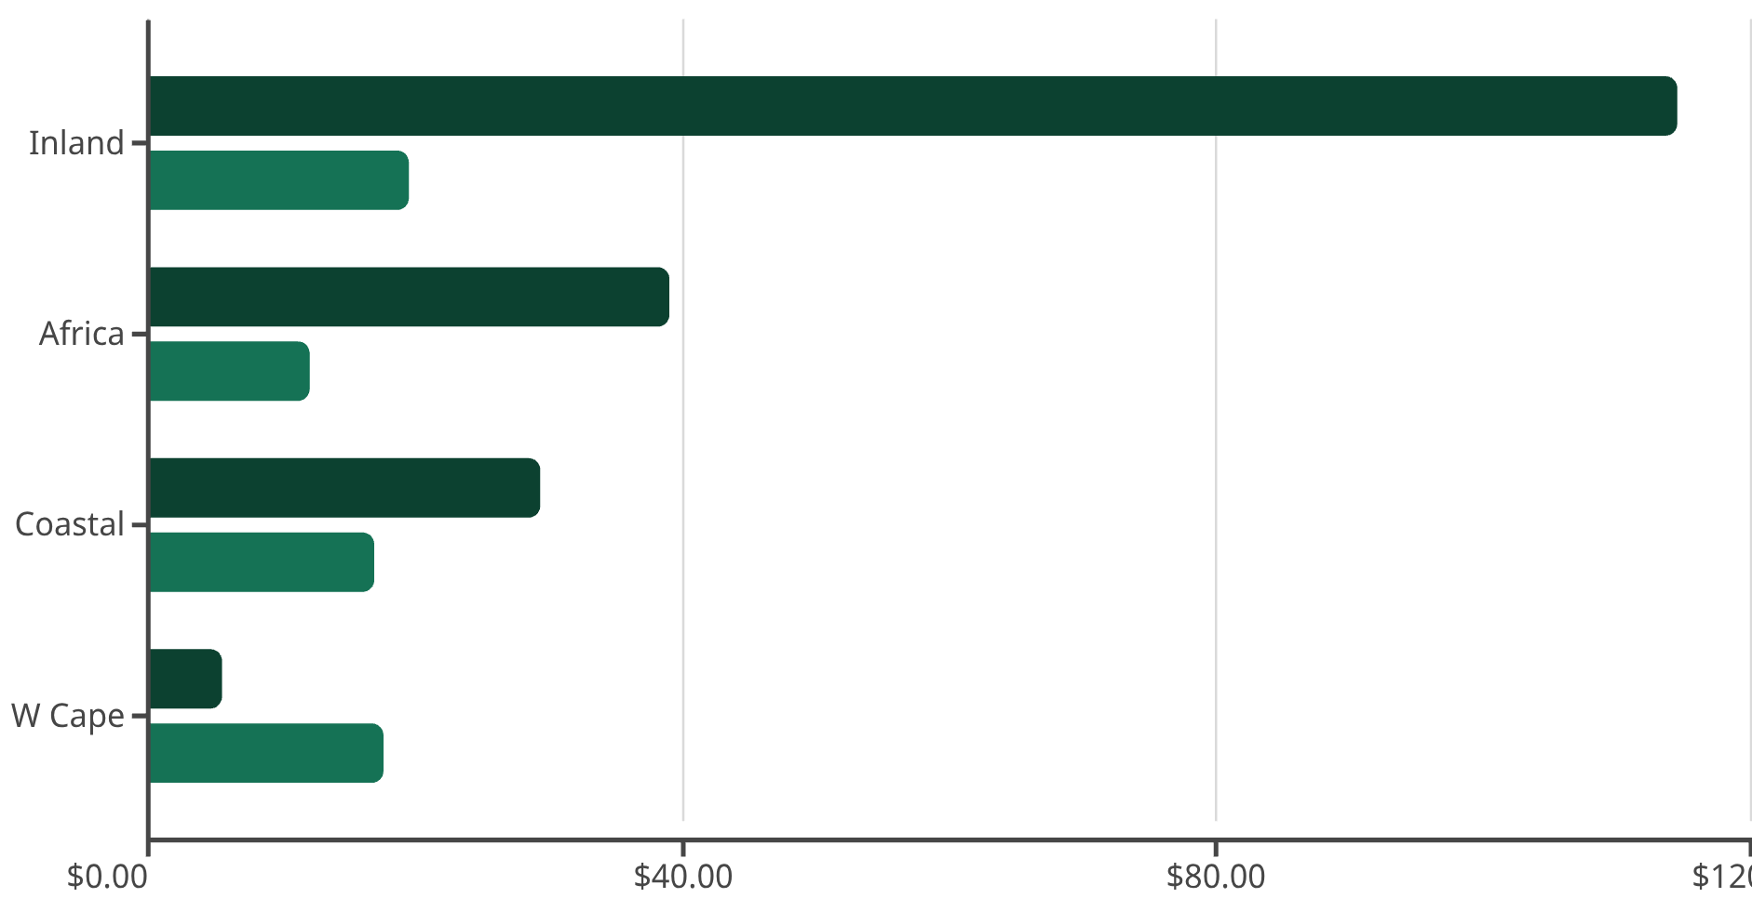
CHAPTER 2
Financial Impact Analysis
Overall Cost Structure
Total labour investment for October 2024 reached R188.6 million, with overtime premium representing a concerning proportion of total costs:
Normal Time
OT1 Weekday/Saturday
OT2 Sunday/Holiday
Industry Context: Construction sector benchmarks suggest overtime should represent 10-15% of labour costs. At 19.3%, Stefanutti Stocks operates 29% above the upper benchmark, representing approximately R8.1M in potential monthly optimization opportunity.
Regional Cost Distribution
Overtime distribution varies significantly across regions, revealing concentration in specific geographic areas:
Total Cost (R Millions)
OT Percentage
Critical Insight: Inland region drives 60.7% of total costs and exhibits the highest overtime percentage (19.6%)—63% higher than the Africa region baseline. This concentration suggests region-specific operational challenges centered around Roads & Earthworks contracts, which are timeline-sensitive, weather-dependent, and equipment-intensive.
Project-Level Risk Assessment
Contract
Region
Discipline
Total Cost
OT %
Risk
CSCIVSB467
Coastal
Roads & Earthworks
R8.0M
33.3%
🔴 Critical
INLECI1550
Inland
Electrical & I
R6.6M
34.7%
🔴 Critical
INREP35500
Inland
Roads & Earthworks
R10.5M
27.5%
⚠️ High
INREP34900
Inland
Roads & Earthworks
R9.1M
22.8%
⚠️ High
INLECI1510
Inland
Electrical & I
R6.8M
22.6%
⚠️ High
Three of the top five highest-cost projects are Roads & Earthworks initiatives, with two projects (CSCIVSB467 and INLECI1550) exceeding 33% overtime—an operationally unsustainable level indicating aggressive client timelines, sequential dependencies causing overtime cascades, and potential understaffing relative to project scope.

Slide 5
CHAPTER 3
Operational Pattern Analysis
Which Roles Drive Overtime?
Overtime concentrates heavily in production and logistics roles rather than skilled technical trades, revealing systemic capacity challenges:
36.6%
31.3%
30.5%
Operator - Crusher
Assistant - Diesel Bowser
Operator - Diesel Bowser
2 employees averaging 106.2 OT hrs each - continuous production requirement
1 employee with 93.0 OT hrs - refueling operations support role
2 employees averaging 110.4 OT hrs - critical support equipment
30.3%
29.6%
Driver (all types)
Driver - Dump Truck
18 employees averaging 59.6 OT hrs - material transport operations
34 employees averaging 33.7 OT hrs - hauling operations backbone
Why These Roles? These are operational flow positions that cannot stop mid-shift when crushers are processing materials, dump trucks are in transit, or refueling is needed. Stopping operations equals production loss, project delay, and equipment downtime. In contrast, skilled trades (electricians, welders, fitters) show lower overtime percentages because their work is task-based and can be scheduled more flexibly.
Weekend Work Economics
Cost Optimization Opportunity
Sunday/Holiday Work (OT2 Premium):
Every hour moved from Sunday (R300/hr) to weekday OT1 (R225/hr) saves R75 per hour. Weekend work concentrates on Sundays, suggesting client-mandated schedules, catch-up work from delayed weekday progress, and deadline-driven compression.
Total OT2 hours: 29,464 hours
Cost impact: R3.59M at double-rate
Primary regions: Inland infrastructure projects
Potential monthly savings: ~R2.2M if work can be strategically rescheduled.
Safety & Compliance Concerns
Analysis flagged records where employees worked more than 12 hours in a single day—a potential safety risk and labour law compliance concern under South Africa's Basic Conditions of Employment Act, which limits ordinary hours to 45 per week and overtime to 10 hours per week. Projects with repeated excessive-hours violations require operational review to ensure compliance and worker welfare.

Slide 6




CHAPTER 4
Root Cause Hypothesis
Why is Overtime Concentrated in Inland Infrastructure Projects?
Project Type Characteristics
Roads & Earthworks represent weather-dependent work with compressed schedules. Infrastructure projects include client-penalty clauses for delays, and civils work involves sequential dependencies where Phase B cannot start until Phase A is complete.
Production Flow Dynamics
Crushing operations must run continuously once started due to high setup costs. Dump truck fleets optimize around crusher output—stopping operations means idle equipment and lost productivity. Material stockpiling windows are limited by site constraints.
Scheduling Constraints
Client-mandated work windows (such as road lane closures only on weekends), equipment rental periods requiring maximized utilization to avoid idle costs, and subcontractor coordination with multiple trades on the critical path all compress available working time.
Potential Capacity Mismatch
Projects INREP35500 and INREP35700 combined employ 356 people with 27-37% overtime. This suggests original labour estimates were too conservative, project scope changed without workforce adjustment, or equipment capacity limits crew size.

Slide 7
RECOMMENDATIONS
Strategic Recommendations
01
02
03
Immediate Actions (0-30 days)
Standardize External Employee Data
Implement Overtime Approval Workflow
Project Audit - High OT% Contracts: Target CSCIVSB467 (33.3% OT) and INLECI1550 (34.7% OT) with operations reviews to identify bottlenecks. Determine if project timelines are realistic, equipment capacity matches labour force, and whether Sunday work can be rescheduled.
Solve the PDF problem: Require standardized data format in future client contracts to eliminate client-provided PDF reports that lack discipline categorization, enabling better cost tracking and resource planning across all clocking systems.
Add control layer: Deploy digital approval system linking time records to project budgets, enabling real-time budget tracking, early intervention on cost overruns, and visibility into overtime authorization patterns.
Medium-Term Optimizations (30-90 days)
Shift Schedule Optimization
Sunday Work Reduction
Equipment Capacity Analysis
Model 10-hour shifts versus 9-hour plus 3-hour OT patterns for crusher operators (36.6% OT) and drivers (30.3% OT). Evaluate 4-day versus 5-day shift rotations.
Target 30% reduction in OT2 hours through improved weekday planning. Map Sunday work to specific constraints and negotiate expanded weekday work windows with clients where possible.
Compare equipment hours versus labour hours per project in Inland region to test hypothesis that equipment constraints force extended crew hours.
Outcome: Business case for equipment investment versus continued OT costs
Expected ROI: If 20% of OT converts to NT, monthly savings = ~R7.3M
Potential savings: R1.1M/month
Long-Term Strategic Initiatives (90+ days)
Automated Time & Attendance Integration
Predictive Overtime Modeling
Cross-Regional Best Practice Sharing
Build single unified platform ingesting all clocking systems in real-time via API integration with client access control systems. Benefit: live overtime alerts, automated cost forecasting, immediate discrepancy detection.
Deploy machine learning model trained on project characteristics (type, region, contract value, weather data, crew composition) to predict OT risk. Use case: bid more accurately by factoring realistic OT costs into proposals.
Africa region operates at 12.1% OT (benchmark-compliant). Document Africa's scheduling practices and pilot in Inland. Potential impact: If Inland reaches 15% OT, monthly savings = ~R5.2M

Slide 8
CHAPTER 5
Data Quality & Future Enhancements
Current Data Limitations
Recommended Data Enhancements
Missing Contextual Information
For Next Analysis Cycle:
No visibility into planned versus actual hours (is OT reactive or scheduled?), no link to project budgets (is OT within approved allocations?), and no weather data to correlate delays with weather events.
1
Project Budget Data
Calculate variance against approved OT allocations
External Employee Gap
Client system employees lack discipline tags, making it difficult to analyze OT patterns by functional area for external workforce. Recommend flagging this as data requirement in future client contracts.
2
Equipment Utilization Logs
Test equipment capacity hypothesis
Absence of Cost-to-Complete Data
Can see current OT percentage but not project progress. Unable to assess if high OT is justified by ahead-of-schedule delivery or superior project outcomes.
3
Weather History
Separate controllable vs. uncontrollable delays
4
Project Milestone %
Assess OT productivity ROI
5
Client Penalty Clauses
Understand Sunday work economics

Slide 9
CONCLUSION
From Data to Decisions
This analysis transformed fragmented time and attendance data into actionable intelligence, revealing that Stefanutti Stocks' overtime costs represent 19.3% of labour budget—significantly above industry norms and creating substantial optimization opportunities.
The Problem is Concentrated
This is Fixable
Data Integration Unlocked Visibility
60% of costs stem from Inland region
Estimated R8.1M monthly optimization opportunity by reaching 15% benchmark
Successfully merged two clocking systems operating in silos
Roads & Earthworks projects drive the pattern
Sunday work reduction: R1.1M/month potential savings
Identified critical data quality gaps
Production roles (crushers, drivers) bear the overtime burden
Created foundation for predictive analytics
Shift schedule optimization could convert significant OT to NT
What This Analysis Enables
Immediate
Strategic
Project managers can now identify high-OT contracts and investigate root causes with data-driven precision
Finance can build more accurate project bids incorporating realistic OT forecasts based on historical patterns
1
2
3
Near-term
Operations can model shift schedule changes with confidence in accurate, validated data foundations

Slide 10

Appendices
Appendix A: Data Sources
Appendix C: Technical Methodology
Biometric system CSV export (internal employees)
Tools & Technologies:
Client-provided PDF reports (external employees)
Python (pandas, regex) for PDF parsing and data consolidation
Assumed pay rates: NT=R150/hr, OT1=R225/hr, OT2=R300/hr
Custom regex patterns for multi-line entry handling
Appendix B: Definitions
Power BI for interactive dashboard and executive reporting
DAX measures for dynamic cost calculations and KPIs
Normal Time (NT): Scheduled hours, typically 07:00-17:00 less 1hr lunch = 9hrs
Appendix D: Analysis Scripts
OT1: Weekday after-hours + Saturdays (1.5x rate)
Complete analysis scripts and interactive dashboard available upon request
OT2: Sundays and public holidays (2.0x rate)
Core Employees: Permanent staff
LDC: Limited Duration Contractors
Portfolio Note: This analysis demonstrates proficiency in data extraction from unstructured sources, complex data integration, financial analysis, and translating technical findings into executive-level strategic recommendations.

